Slide 1
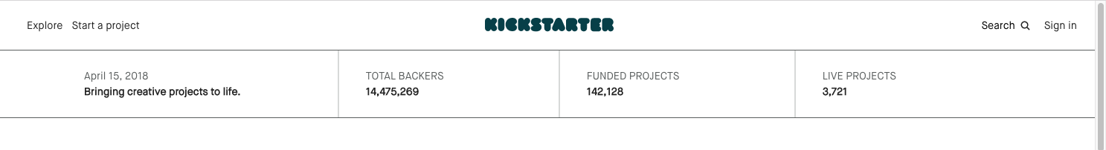
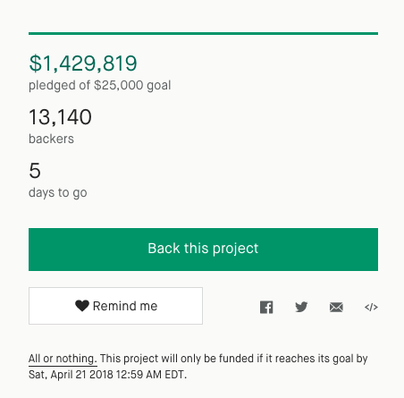
Kickstarter Funding Landscape
Ibrahim Taher
Anant Jain
Sarthak Kothari
Forrest Hooton

Slide 2
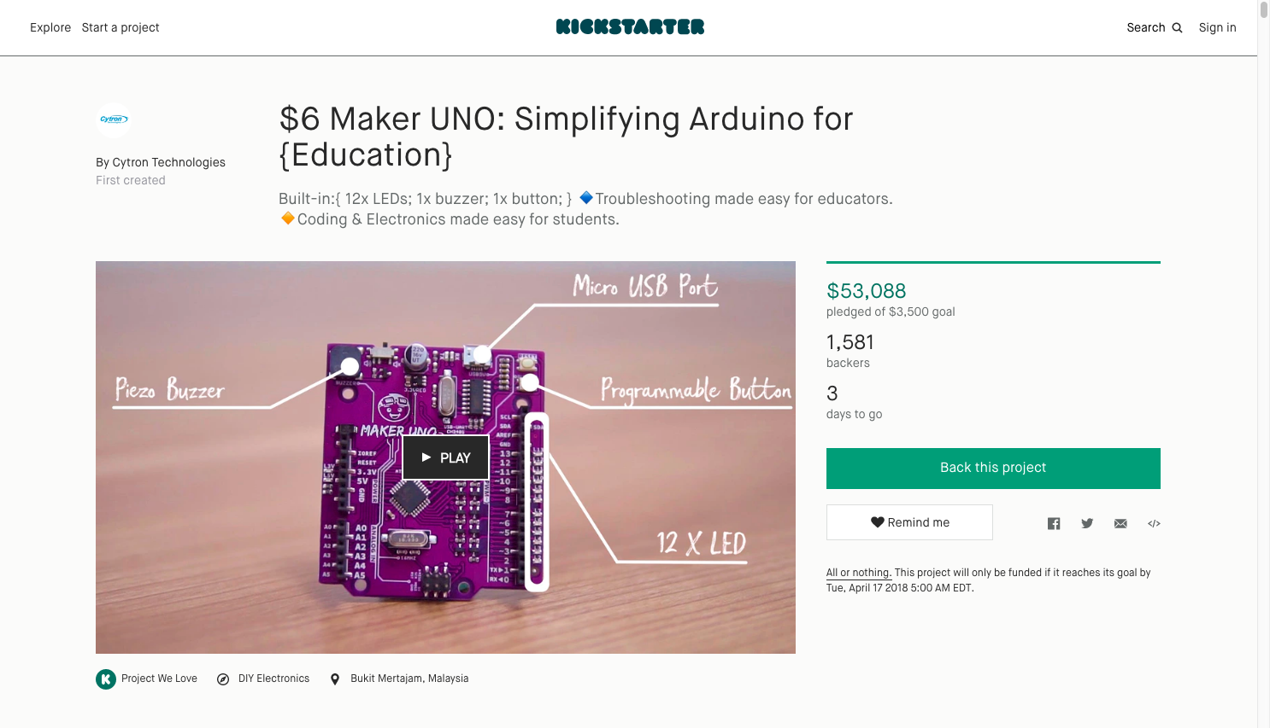
Goal: Understand funding for Kickstarter projects

Slide 3
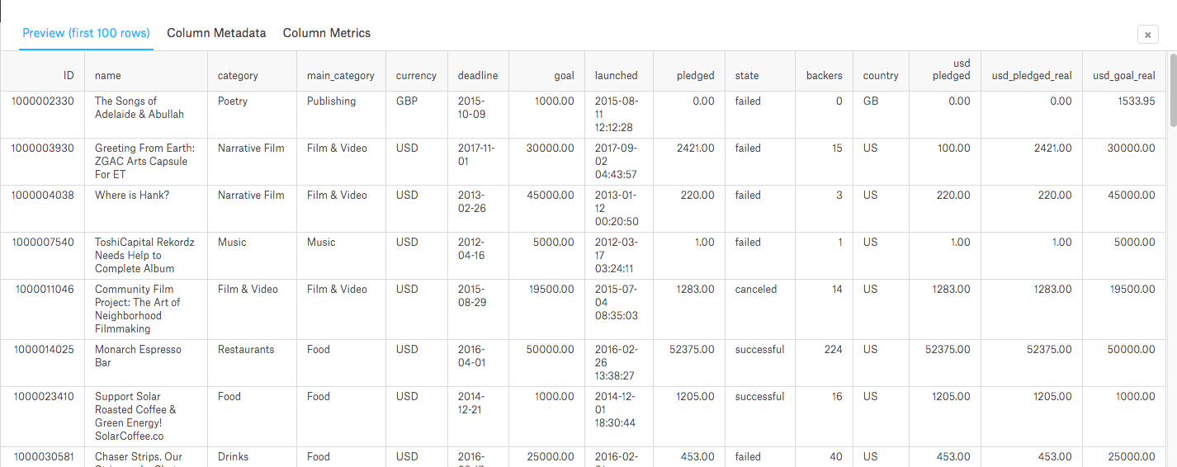
Dataset: Joined Kaggle and JSON data
Used Kaggle dataset for core, clean columns
Joined scraped JSON data for other interesting columns, like text

Slide 4
The Process
Clean
Explore
Model
Parse JSON and join tables
Apply lubridate to datetime data
Added columns for better data
Data partitioning
Overview of funding on kickstarter (ex. Funding across different categories)
Funding in relation to time
Text analysis
Logistic regression to determine whether or not a project is funded
Linear regression model for funding percentage

Slide 5
To Shiny for Exploratory Results!!!

Slide 6
Models
Not great accuracy with only pre-campaign info
60%
Logistic Model Pre-Campaign Info
Reasonable average accuracy
Gives us insight into what influences outcomes, but not prediction
83%
Logistic Model Post-Campaign Info
Linear model for percent funded clearly is not useful
133 RMSE
Linear Model Post-Campaign Info
Best accuracy of all models
88%
Random Forest Post-Campaign Info

Slide 7
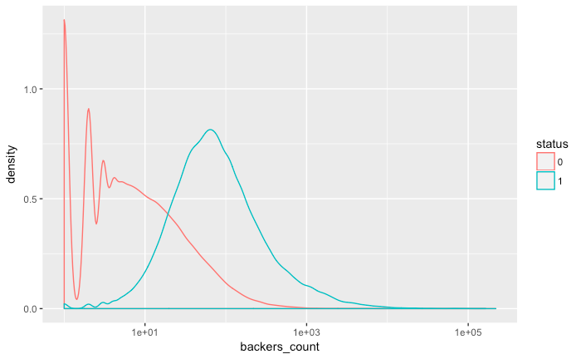
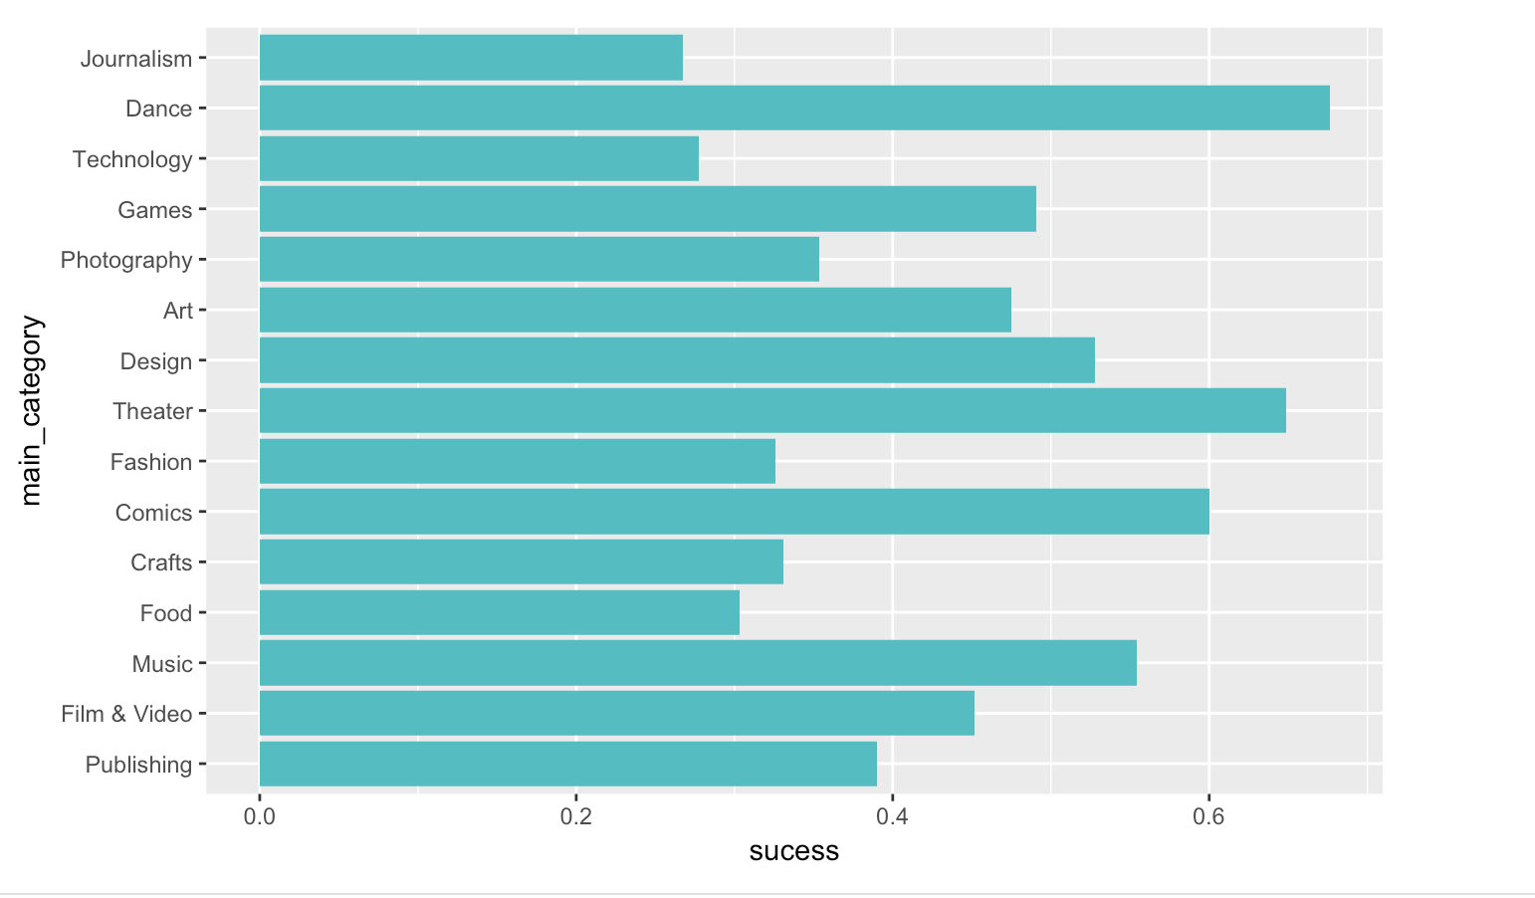
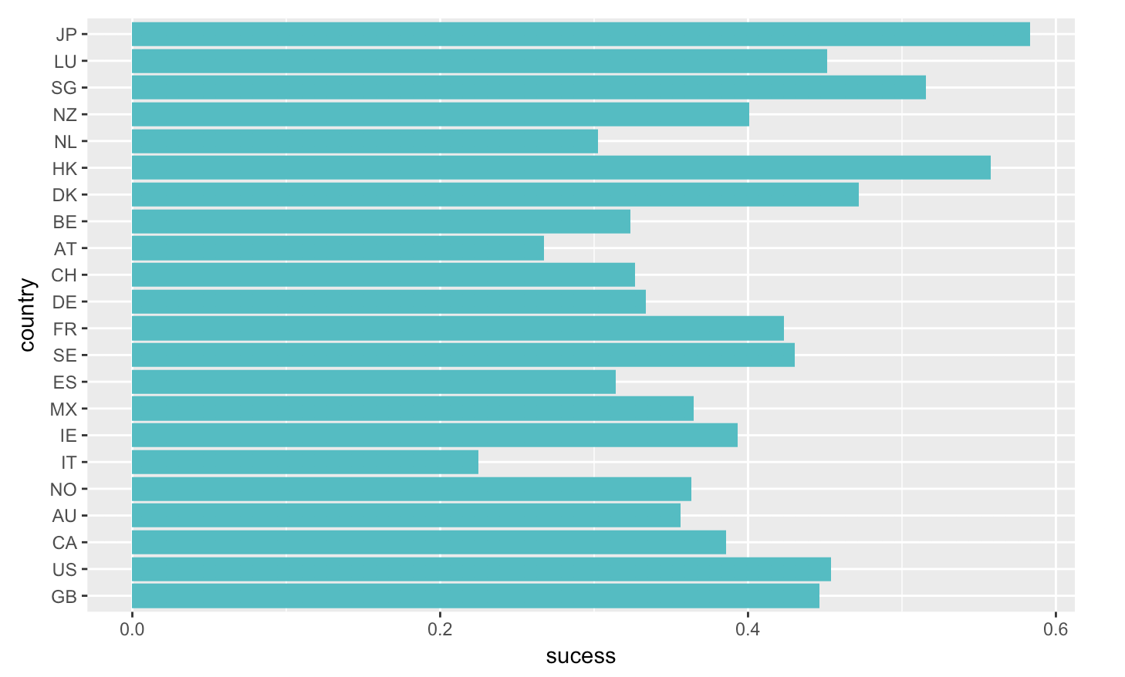
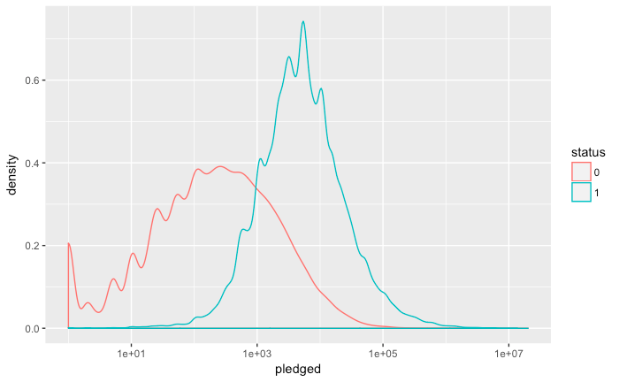
Deeper Look into Logistic Regression
Model: status ~ main_category + backers_count + country + pledged + Month + Year + days_live

Slide 8
Discussion
Better model for whether or not a campaign was successful than degree of success
Descriptive modeling (post-campaign data) is more effective than predictive modeling (pre-campaign data)
Categories yielded better results than country during text analysis

